Slide 1
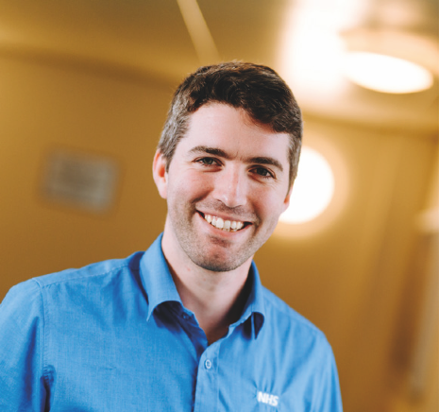


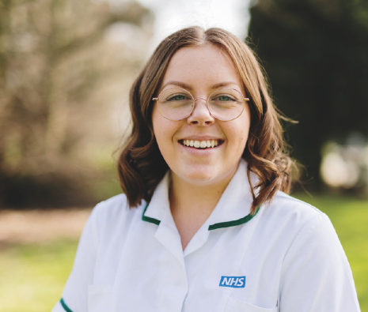
Autism and ADHD diagnostic services

Slide 2

Referral and Triage Process
Getting the documentation right!
Humber Foundation NHS Trust Children's Neurodiversity Service
House keeping
Documentation Journey so far (good and the bad)
Current process and future plans
The essential info
Break out groups for review of documentation
Focus on referral documentation Autism and ADHD diagnostics

Slide 3
Challenges and Strengths
Challenges
Strengths
Too Long
Asks for information repeatedly
difficult language used
poor quality of information
only part of forms completed
No self screening form for young people
Know the information we need, based on guidance/standards
Consent and standard demographics must be collected at certain points
Needs to meet Trust access standards
Need to consider support options to help people fill in the forms
Quality Improvement Plan around the referral process

Slide 4
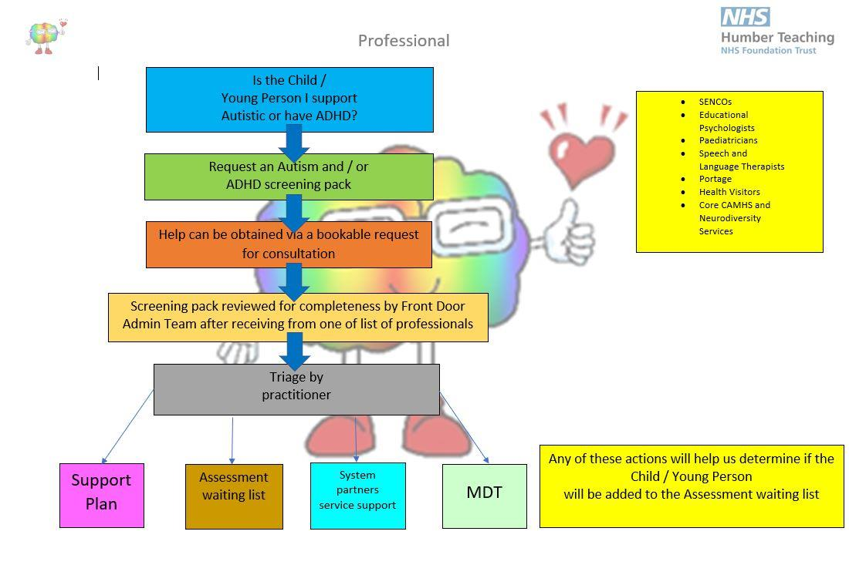

Slide 5
Next steps
Review referral documentation
Digitalise
Align with pre allocation packs and first assessment forms
Consider training needs for professionals completing the forms
Distribute links to new paper work - options for people without access to technology

Slide 6
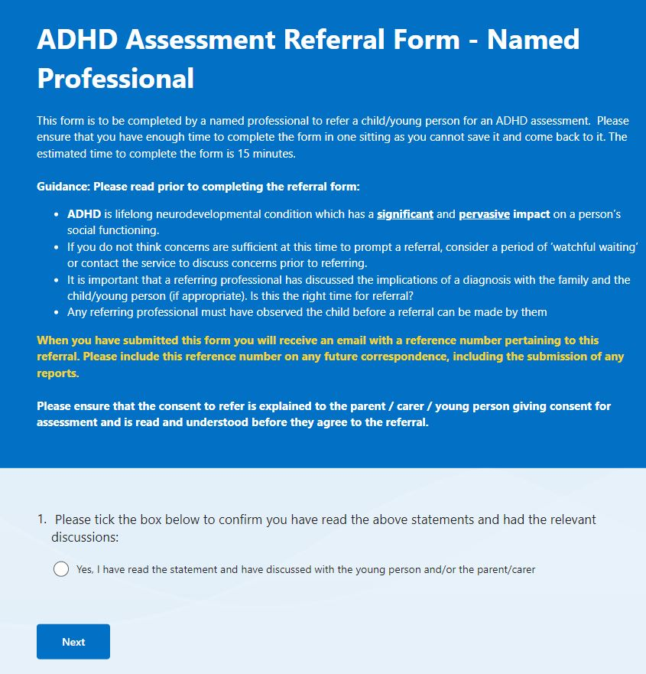
Digital form example

